Slide 1
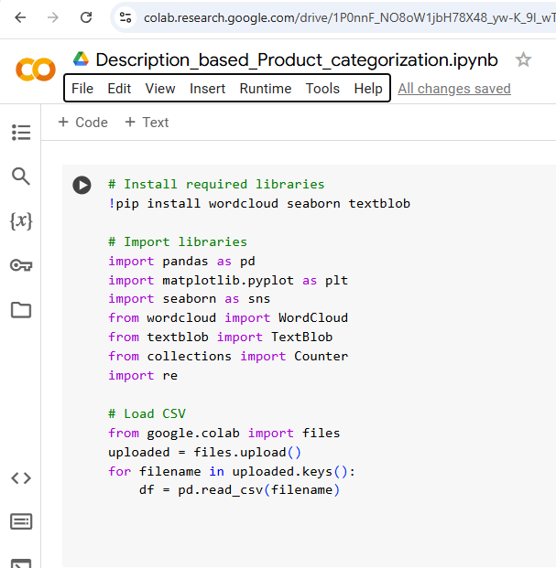
Import csv train produuct data

Slide 2
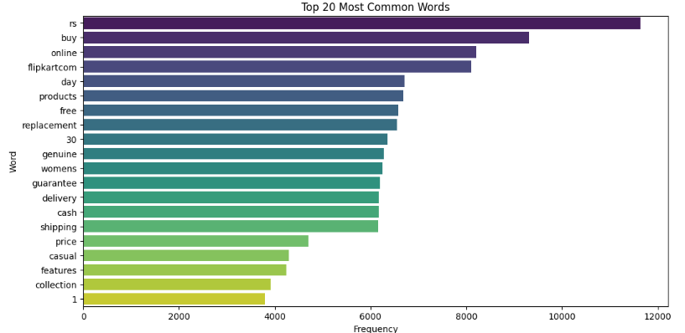
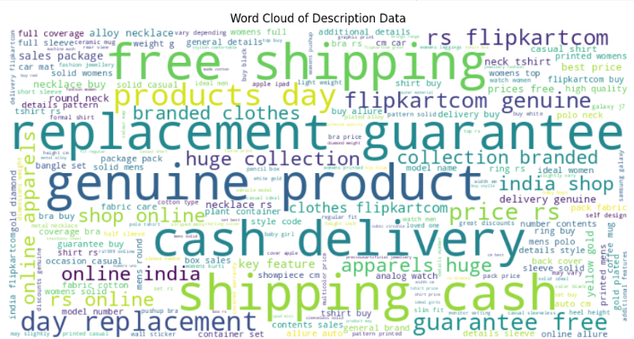
Remove stopwords and visualize words

Slide 3
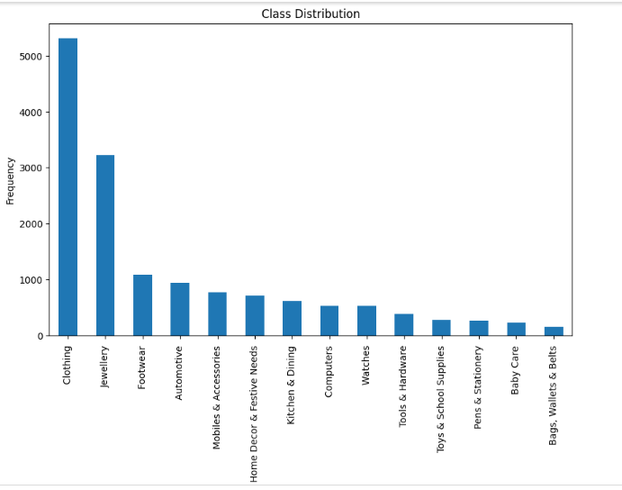
Category vs Freq

Slide 4
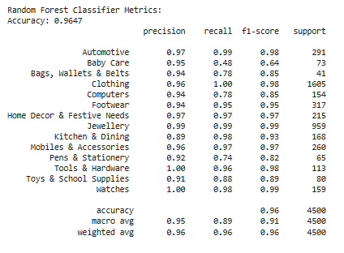
Random Forest Classifier Accuracy

Slide 5
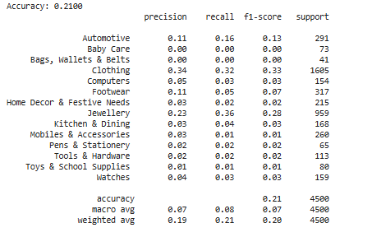
Accuracy of deep learning

Slide 6
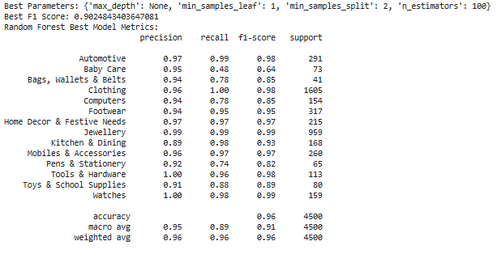
After Tuning Random forest Classifier

Slide 7
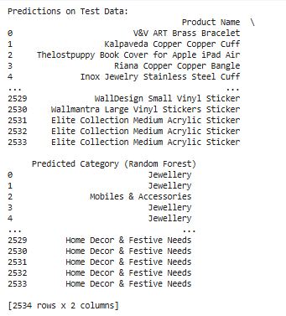
Predictions of category based on description

